Slide 1
Soccer robot perception
PrATIKA KOCHAR

Slide 2
1.
Motivation
2.
Problem Statement
3.
Datasets
AGENDA
4.
Preliminaries
5.
Implementation
6.
Results and Model Evaluation
2

Slide 3
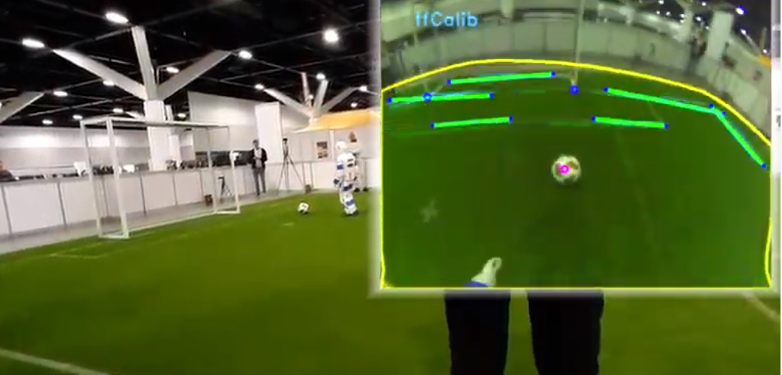
motivation
Humanoid League contributes to the goal of beating the human soccer world champion by 2050 by gradually training the robot all FIFA rules (making the game rules more)
New constraint: Field dimensions updated to 14×9 m (from 9x6 m), with 2 players (robots)
Problems:
Perception (further away balls and goalposts to be detected)
Localization (robust line detection and state estimation)
Today’s talk is based on:
RoboCup 2019 AdultSize Winner NimbRo: winner of all competitions in the AdultSize class for the RoboCup 2019 Humanoids League in Sydney

Slide 4
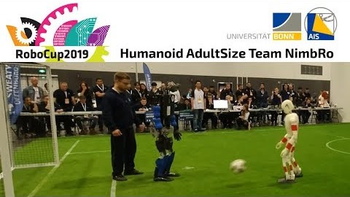
Motivation

Slide 5
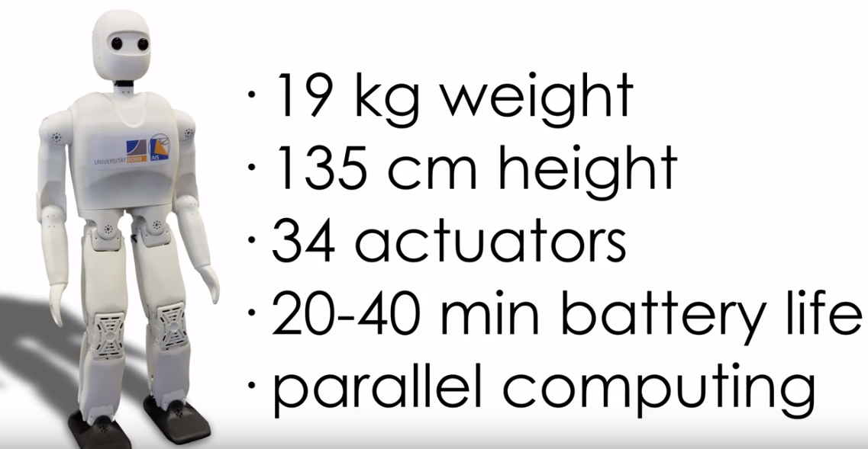
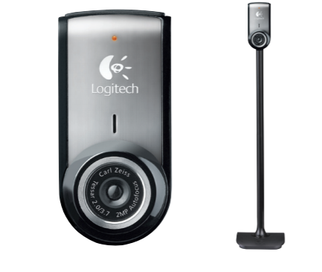
NimbRo Specs
visual perception: Logitech C905 USB camera with wide-angle lens
Robust to very bright and very dark conditions
Detection range 10 m
NimbRo robot
NimbRo
Logitech C905 USB camera
Notes:
33566311_001-1

Slide 6
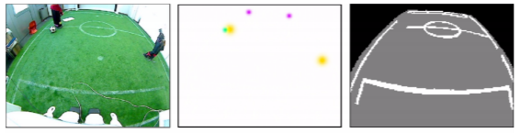
Problem Statement
Reproduction of existing visual perception system for soccer-related objects
Detecting ball, goalposts, and robots
Classification (segmentation) of field and lines
through the usage of texture, shape, brightness, and color information
Image captured by robot
Expected output of the network indicating balls (cyan), goal posts (magenta),
and robots (yellow).
Expected output of the segmentation branch showing lines (white), field (gray), and background (black)

Slide 7
DAtaSETs
Two datasets:
Object Detection for ball, goalposts, and robots
Input RGB image, along with annotations containing landmark points for each relevant object
Segmentation for background, field and lines
Input RGB image, along with the ground truth (mask)

Slide 8
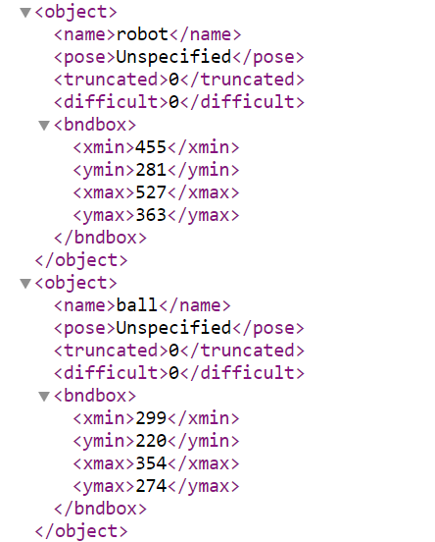
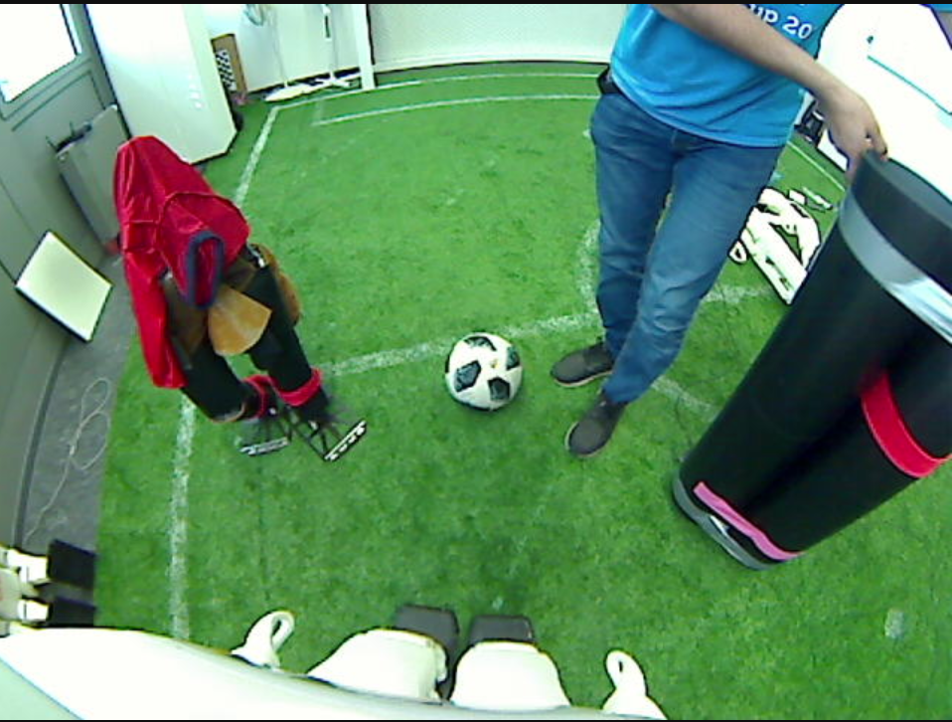
DATA Set For Object Detection
Training Data: 1598 images Test Data: 150 images Validation Data: 150 images
XML containing locations for ball, robot, goalpost
Corresponding Input Image

Slide 9
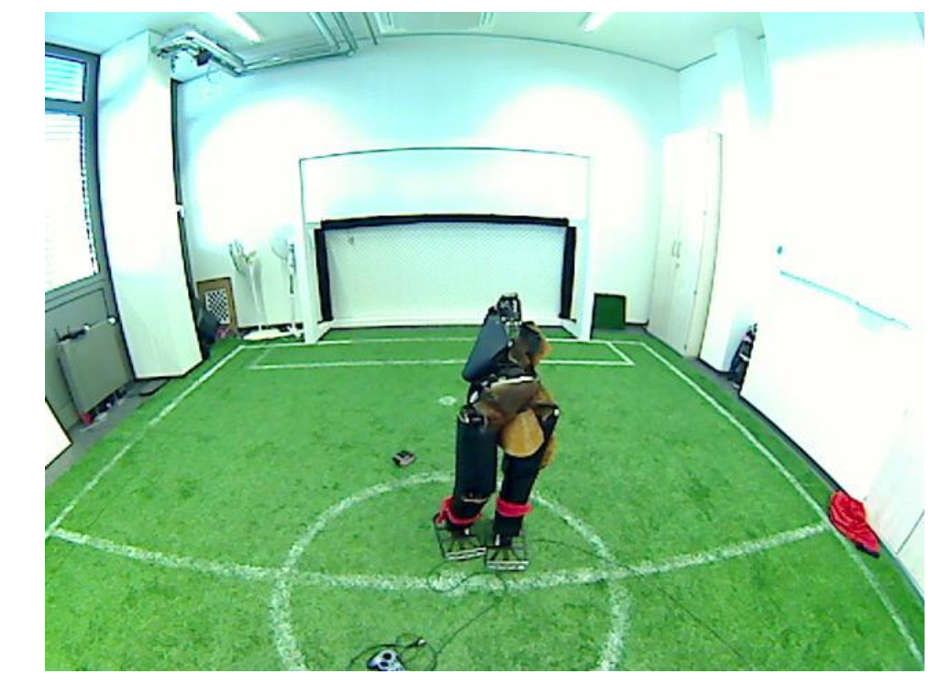
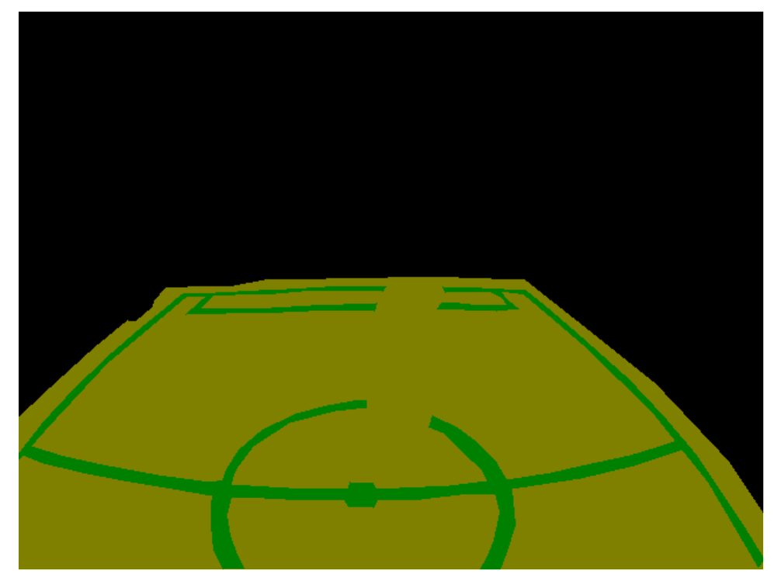
DATA set For Segmentation
Training set: 886 images Test set: 111 images Validation set: 111 images
Input Image
Ground Truth

Slide 10
Key Feature: Location-dependent conv. layer
Requirement?
Recognition of location-dependent features
Why do need this information?
Task of the video prediction, for instance, learning the location of static obstacles in the environment leads to better frame forecasting.
Problem?
Convolutions are location-invariant => Convolutional deep learning architectures cannot recognize location-dependent features
Solution: Location-dependent convolutional layer
Convolutional layers with learnable location-dependent biases

Slide 11
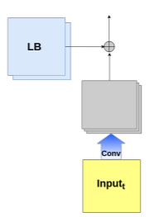
Location-dependent convolutional layer
Replace convolutional layer with location-dependent convolutional layer
where
A is the activation function
W and b are the weight and bias of the specified layer
I(x, y) is the input vector at the Cartesian position (x, y)
W’s are location-dependent weights learned through the training procedure
Location Dependant Convolution
Source: www.ais.uni-bonn.de/~hfarazi/papers/LocDep.pdf

Slide 12
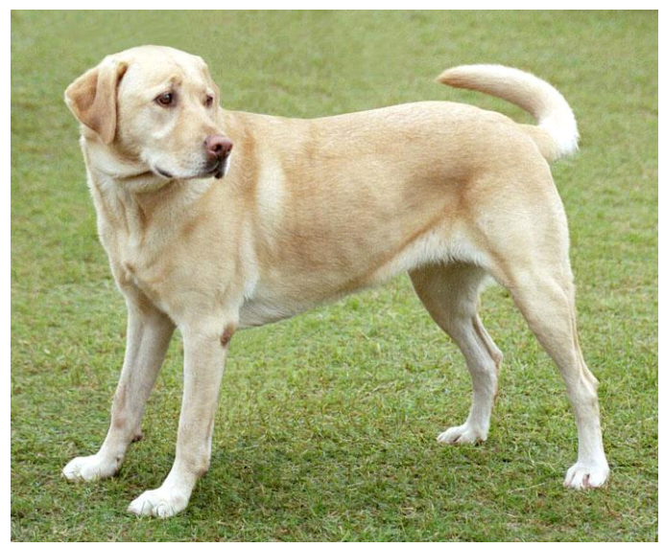
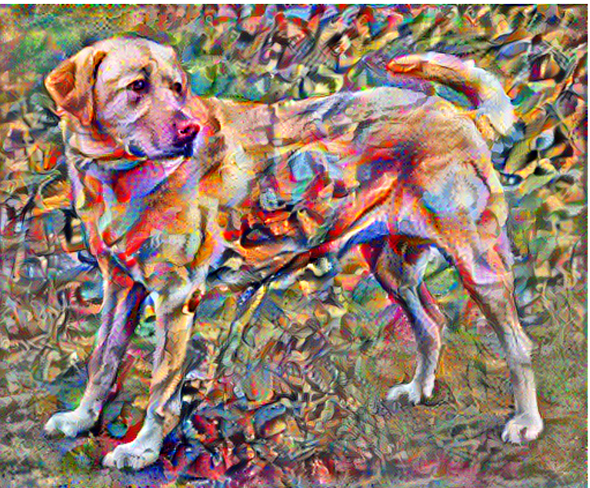
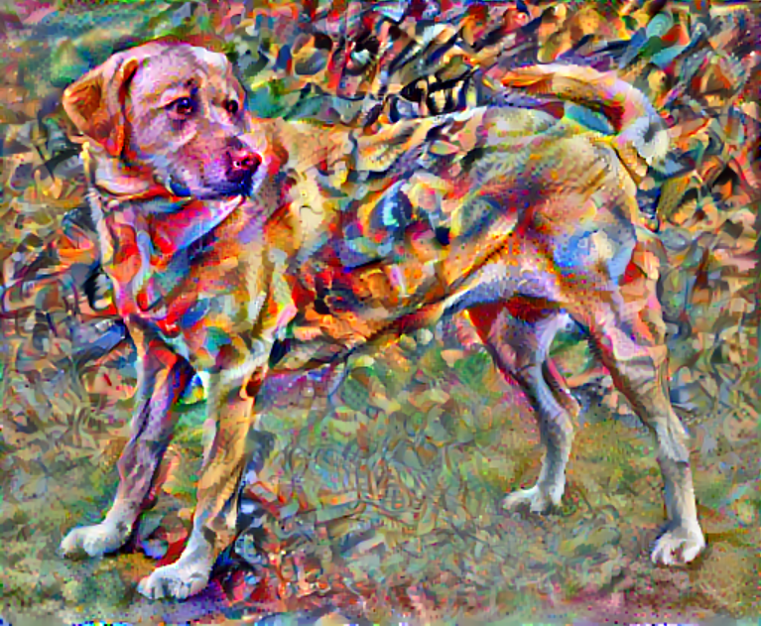
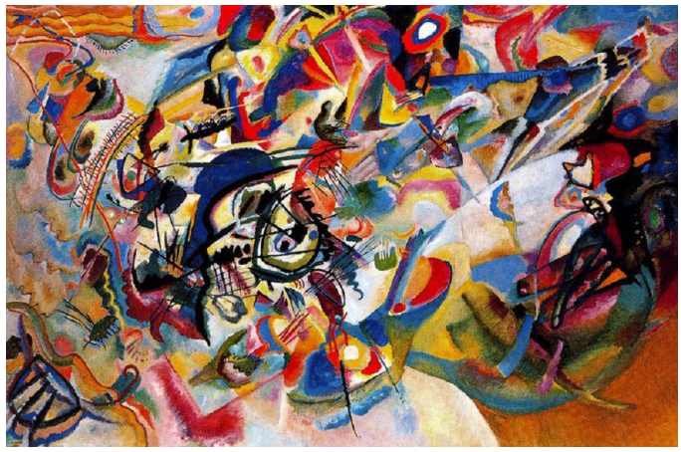
towards Smooth Results
Total Variation Loss
Used to decrease lot of high frequency artifacts by using an explicit regularization term on the high frequency components of the image. In style transfer, this is often called the total variation loss
=
+
or
Without total variation loss
With total variation loss
Source: www.tensorflow.org/tutorials/generative/style_transfer

Slide 13
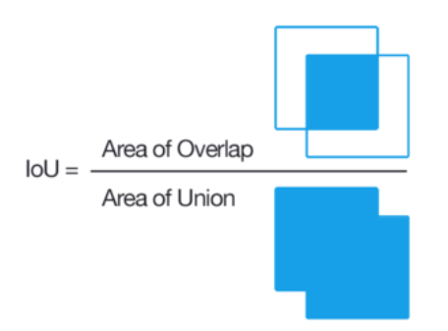
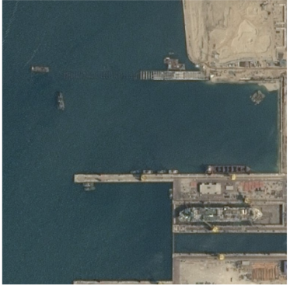
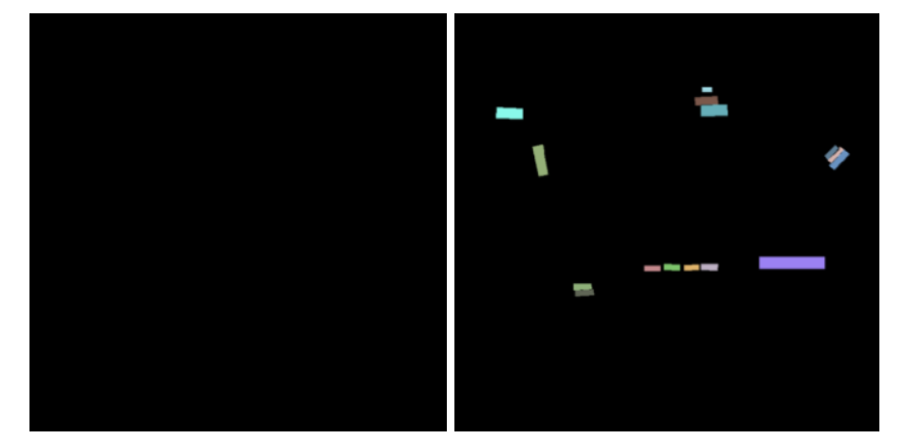
Intersection over Union Metric
Metric ranges from 0–1 (0–100%) with 0 signifying no overlap (garbage) and 1 signifying perfectly overlapping segmentation
Better metric as compared to pixel accuracy in case of class imbalance. For example:
Pixel accuracy* = 95%
IOU* = 47.5 %
Input Image Model Prediction Segmented Ground truth
Source: towardsdatascience.com/metrics-to-evaluate-your-semantic-segmentation-model

Slide 14
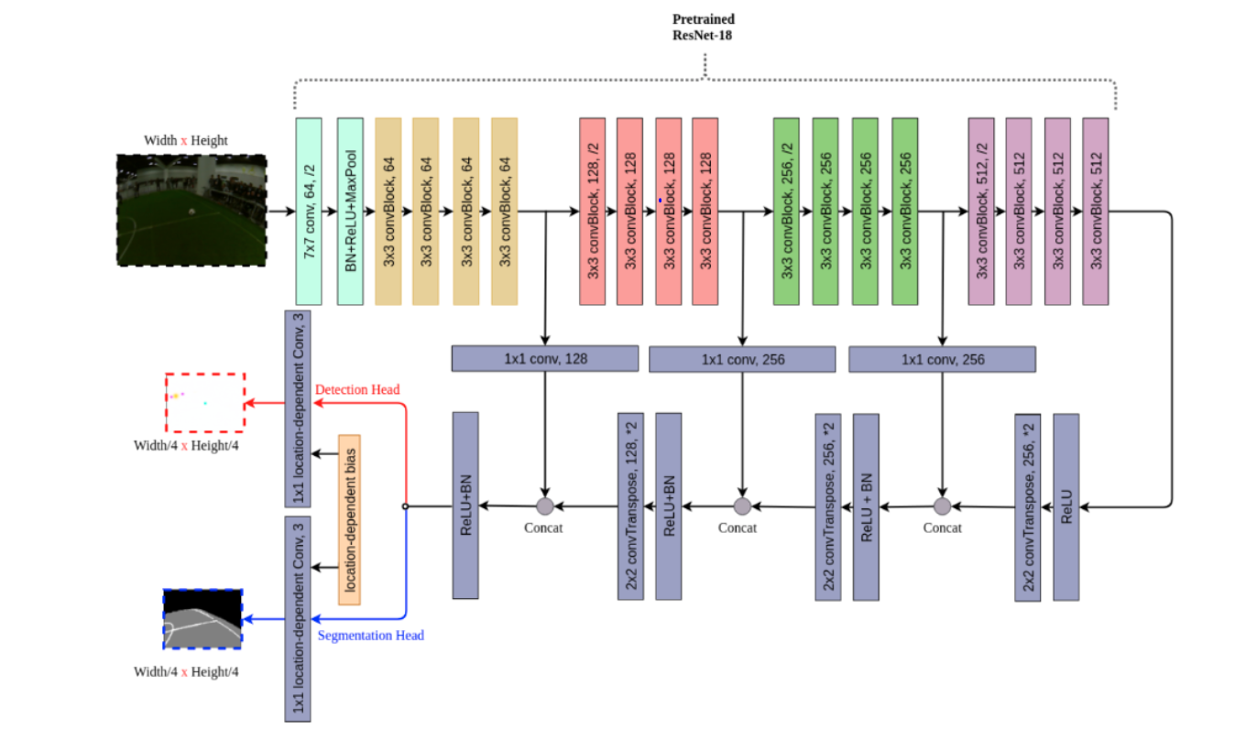
Model architecture
Unified deep convolutional neural network to perform object detection and pixel-wise classification with one forward pass
Encoder-decoder architecture
Since ResNet is originally designed for recognition tasks, Global Average Pooling (GAP) and the fully connected layers in the model are removed
Transpose-convolutional layers for up-sampling the representations
Source: RoboCup 2019 AdultSize Winner NimbRo
Two output heads; one for object detection, and the other for pixel-wise segmentation
Notes:
By accessing intermediate layers of the model, you're able to describe the content and style of input images

Slide 15
Implementation
Model Training
Single model is trained jointly for both tasks
A lower learning rate is employed for the encoder part, with the intuition that the pre-trained model needs less training time to converge
Adam optimizer, which has an adaptable per-parameter learning rate
For Object Detection Head
Target is constructed by Gaussian blobs around the ball center and bottom-middle points of the goalposts and robots
Bigger radius for robots with the intuition that annotating a canonical center point is more difficult
Loss: Mean squared error

Slide 16
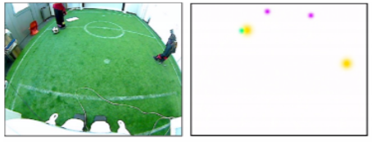
ImpleMeNtation: Object Detection
Heatmap Generation
Define colors for each object
cyan for ball: 0,255,255
magenta for goalposts: 255,0,255
yellow for robot: 255,255,0
2. Define radius for each object
Radius = [11 , 15, 27]
3. Create gaussian kernel for each object
4. Set color depending on the object
5. Insert this kernel on a white image (dimensions as that of input image)
Input Image
Heatmap

Slide 17
IMPLementation: Segmentation
For Segmentation Head
Loss: Pixelwise Negative Log Likelihood
Total Variation loss to the output of all result channels except the line segmentation channel
Total Variation loss encourages blob response => less false positives especially in field detection

Slide 18
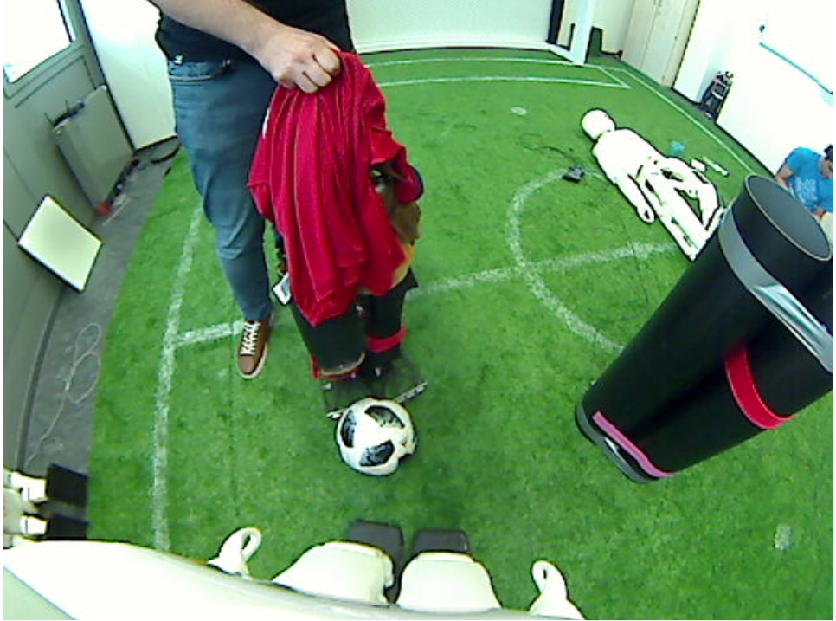
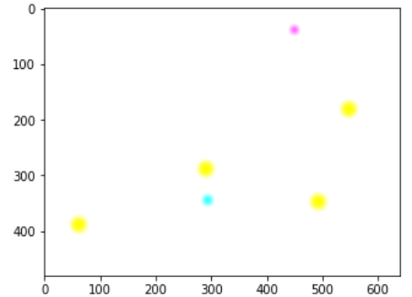
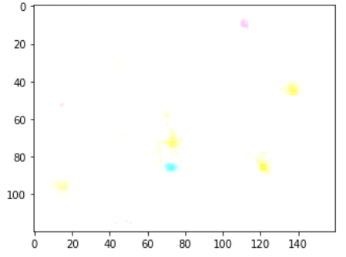
Results
Object Detection Head
Output: A heatmap corresponding to ball, goalpost and robot after thresholding
Input Image
Ground Truth

Slide 19
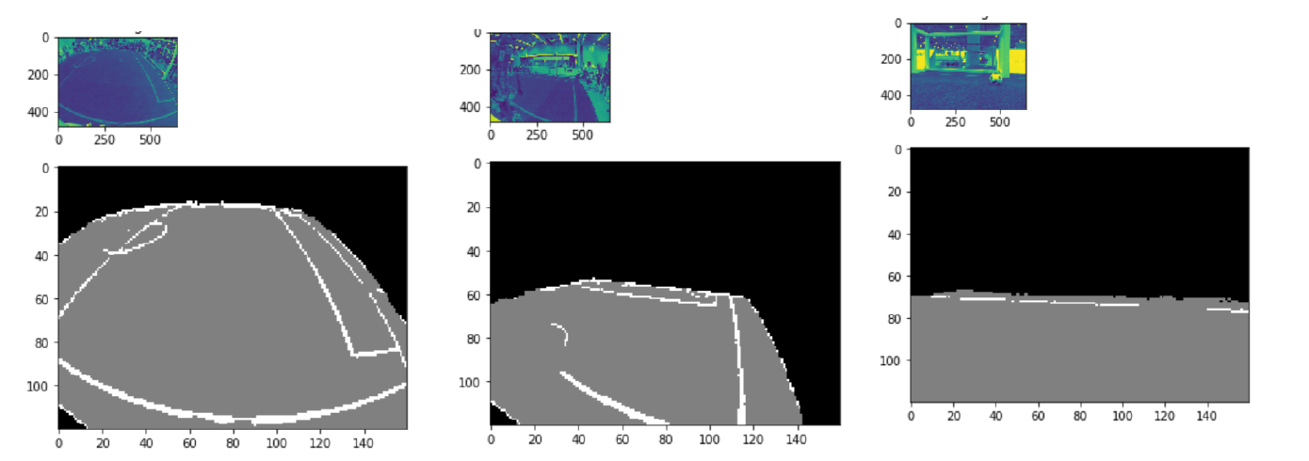
Results
For Segmentation Head
First row corresponds to input images, second row segmented output: White for lines, gray for field, black for background

Slide 20
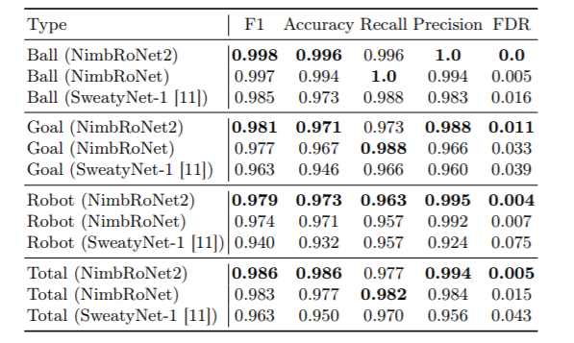
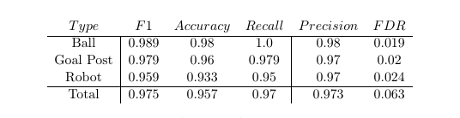
Model evaluation
Object Detection Head
Original implementation
My implementation

Slide 21
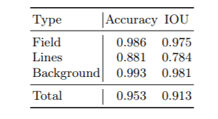
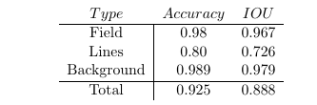
Model evaluation
Segmentation Head
Original implementation
My implementation
Similar results except for (field) lines

Slide 22
Thank you

